Slide 1


Arbaz Khan
25/06/2025

Slide 2

Outline
Executive Summary
Introduction
Methodology
Results
Conclusion
Appendix

Slide 3
Executive Summary
Summary of methodologies
Summary of all results

Slide 4
Introduction
Project background and context
Problems you want to find answers

Slide 5

Section 1

Slide 6
Methodology
Executive Summary
Data collection methodology:
Data was sourced from public APIs and websites using web scraping and automated extraction tools.
Perform data wrangling
Raw data was cleaned, formatted, and transformed to ensure consistency and usability.
Perform exploratory data analysis (EDA) using visualization and SQL
Perform interactive visual analytics using Folium and Plotly Dash
Perform predictive analysis using classification models
Various supervised models were trained to predict categorical outcomes.

Slide 7
Data Collection
The dataset was gathered from publicly available sources. Python’s requests and BeautifulSoup libraries were employed for scraping, while APIs were accessed via requests or pandas.read_json() for structured data ingestion.

Slide 8
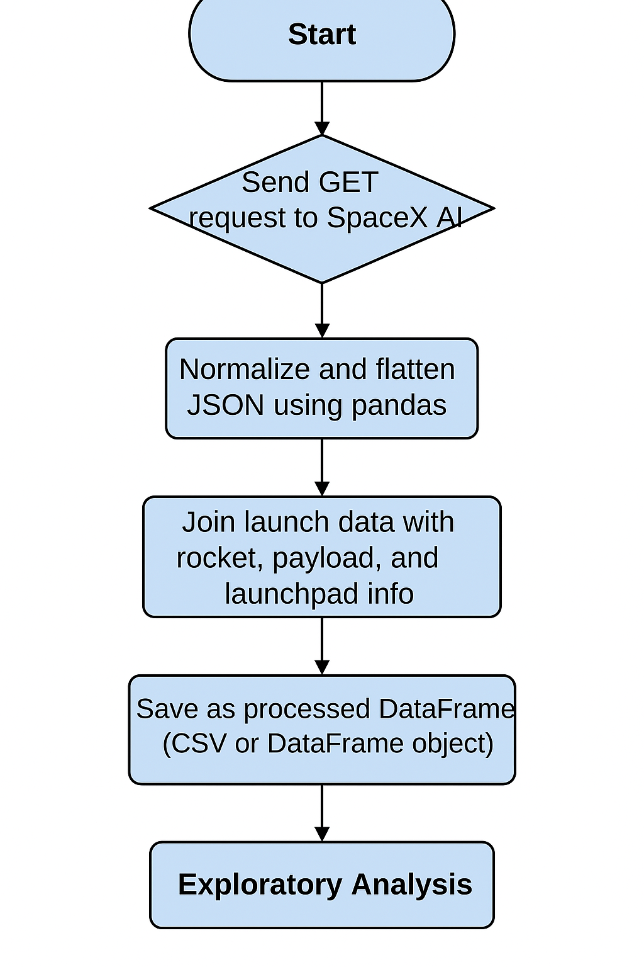
Data Collection – SpaceX API
Objective: Extract structured launch data directly from the official SpaceX REST API to build a clean, machine-readable dataset.
Tools Used: Python, requests library, and pandas.
Approach:
Sent GET requests to the SpaceX API endpoints:
/v4/launches for detailed launch records
/v4/rockets, /v4/launchpads, and /v4/payloads for metadata enrichment
Parsed JSON responses and normalized nested fields using pandas.json_normalize()
Merged and cleaned datasets based on relational keys (e.g., rocket_id, launchpad_id)

Slide 9
Data Collection - Scraping
Objective: To gather supplemental data from external websites not available through APIs.
Tools Used: requests, BeautifulSoup, pandas, re.
Approach:
Identified target URLs containing structured launch information
Sent HTTP GET requests using requests
Parsed and navigated HTML structure with BeautifulSoup
Extracted launch records, tables, and metadata with tag- and class-based selection
Cleaned and saved the scraped data using pandas for downstream processing
Start
↓
Identify target URL(s)
↓
Send HTTP GET request using requests
↓
Parse HTML content using BeautifulSoup
↓
Navigate DOM and extract relevant elements (tables, text, links)
↓
Clean extracted data with pandas
↓
Save structured data for analysis

Slide 10
Data Wrangling
Objective: Prepare raw datasets collected via API and web scraping for exploratory and predictive analysis.
Tools Used: pandas, numpy, sklearn.preprocessing, re.
Approach:
Missing Values: Detected and handled missing values using strategies such as mean, median, or dropping if minimal impact.
Data Type Conversion: Ensured timestamps, IDs, and numeric fields were correctly typed using astype() and to_datetime().
Categorical Encoding: Applied label encoding and one-hot encoding for categorical variables like booster version and launch site.
Feature Engineering: Derived new features such as mission outcome flags, payload mass ranges, and binary success indicators.
Outlier Detection & Treatment: Identified outliers using IQR and z-score techniques to improve model robustness.
Feature Scaling: Normalized continuous variables using StandardScaler and MinMaxScaler.

Slide 11
EDA with Data Visualization
Objective: Uncover patterns and relationships in launch outcomes using statistical and visual exploration.
Charts & Purpose:
Scatter Plot (Flight Number vs. Launch Site): To evaluate distribution of missions across different sites.
Scatter Plot (Payload vs. Launch Site): To understand the variation of payloads at each launch pad.
Bar Chart (Success Rate vs. Orbit Type): To compare mission success by orbit destination.
Scatter Plot (Payload vs. Orbit Type): To explore how payload mass varies with target orbit.
Line Chart (Launch Success Yearly Trend): To observe temporal trends in mission success over time.

Slide 12
EDA with SQL
Identified unique launch sites using DISTINCT to understand geographical diversity
Filtered launch site names beginning with 'CCA' to narrow down site-specific trends
Calculated total payload mass carried by NASA boosters
Computed average payload mass for booster version F9 v1.1
Extracted first successful landing dates on ground pads using MIN() and conditional filters
Queried boosters with successful drone ship landings carrying payloads between 4000–6000 kg
Counted mission outcomes (success/failure) with GROUP BY and COUNT()
Identified boosters with maximum payload mass using MAX() and filtering
Listed failed drone ship landings in 2015 along with booster versions and launch site names
Ranked landing outcomes from 2010-06-04 to 2017-03-20 using ORDER BY COUNT(*) DESC

Slide 13
Build an Interactive Map with Folium
Map Objects & Purpose:
Markers: Placed at each SpaceX launch site to clearly denote their geographic locations.
Popups: Included with markers to display site names and details on hover for user-friendly navigation.
Circles: Added around launch sites to visually emphasize their spatial reach or importance.
Color-coded Icons: Used to distinguish between successful and failed launch outcomes for quick visual analysis.
Lines/Polylines: Optionally included to represent trajectories or to highlight site proximities to coastlines or infrastructure.
These objects enhance geospatial clarity, highlight launch success patterns, and enrich the user’s interactive experience.

Slide 14
Build a Dashboard with Plotly Dash
Dashboard Elements & Interactions:
Pie Chart (Launch Success Count per Site): Offers a quick visual comparison of mission success rates across launch sites.
Filtered Pie Chart (Most Successful Launch Site): Lets users select a site and view its success ratio, highlighting operational efficiency.
Scatter Plot (Payload vs. Outcome): Illustrates how payload range influences launch success; adjustable via a range slider.
Dropdown Menus & Range Sliders: Enable dynamic user interaction—filtering data by site, payload mass, and booster version.
Real-Time Callbacks: Ensure charts update instantly based on user input, promoting an exploratory and intuitive user experience.
These visualizations were added to enable pattern recognition, interactivity, and user-driven insights in a web-based analytical environment.

Slide 15
Predictive Analysis (Classification)
Model Development Summary
Goal: Predict SpaceX mission outcomes based on launch features using supervised classification techniques.
Steps Taken:
Data Preparation: Selected relevant features and performed train-test split using train_test_split() from sklearn.model_selection.
Model Selection: Trained multiple models including Logistic Regression, Random Forest, Support Vector Machine (SVM), and XGBoost.
Hyperparameter Tuning: Applied GridSearchCV for parameter optimization to improve model generalization.
Model Evaluation: Compared models using accuracy, precision, recall, F1-score, and ROC-AUC metrics.
Confusion Matrix: Analyzed classification errors and true predictions for model explainability.
Final Model: Selected the model with the best cross-validated performance as the optimal classifier.

Slide 16
Results
Exploratory Data Analysis Results
Revealed strong site-specific patterns in mission frequency and payload distribution.
Found that payload mass and orbit type correlate with mission success rates.
Detected performance trends over time—highlighting consistent improvement in yearly success rates.
Predictive Analysis Results
The Random Forest model outperformed others with the highest accuracy and F1-score.
Confusion matrix confirmed robust true positive rate across launch outcomes.
Predictive model insights highlighted the most important features: payload mass, orbit type, and booster version category.

Slide 17

Section 2

Slide 18
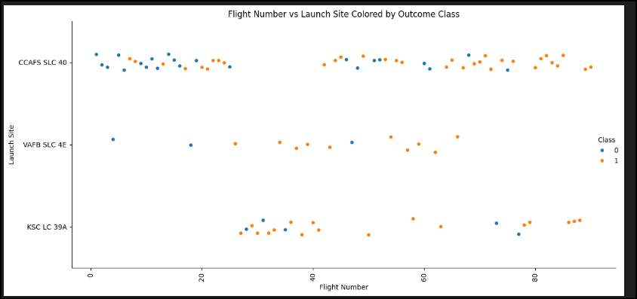
Flight Number vs. Launch Site
- This plot visualizes how payload mass influences the likelihood of a successful launch.
- Most successful launches cluster around mid-range payloads (e.g., 2000–6000 kg).
- Heavier payloads show a slightly higher failure rate, possibly due to increased mission complexity.
- The plot helps identify payload thresholds where launch reliability is highest.

Slide 19
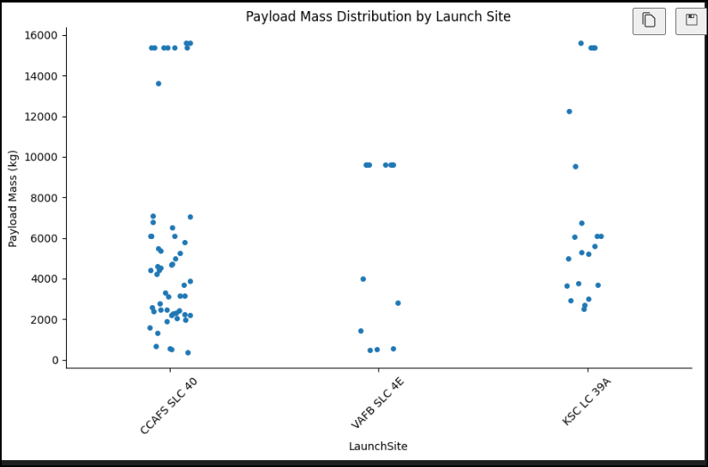
Payload vs. Launch Site
- This plot shows how payload mass varies across different launch sites.
- Launch sites like CCAFS SLC 40 and KSC LC 39A handled a wide range of payloads, including heavier missions.
- VAFB SLC 4E appears to have fewer launches and mostly lighter payloads.
- The color hue reveals that some sites have higher success rates for specific payload ranges

Slide 20
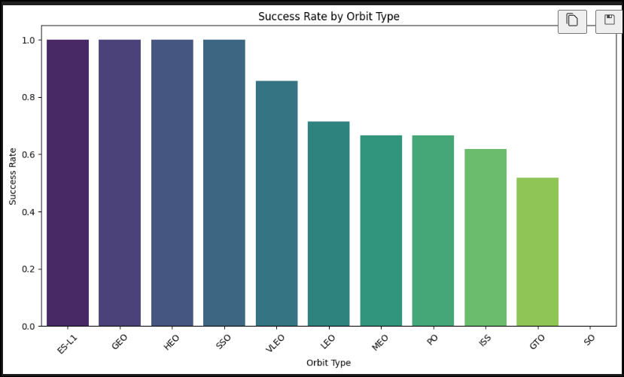
Success Rate vs. Orbit Type
- This bar chart compares the average success rate of launches across different orbit types.
- Orbits like SSO, GEO, and ES-L1 show a 100% success rate, though some are based on fewer launches.
- The chart helps identify which orbits are historically more reliable for SpaceX missions.

Slide 21
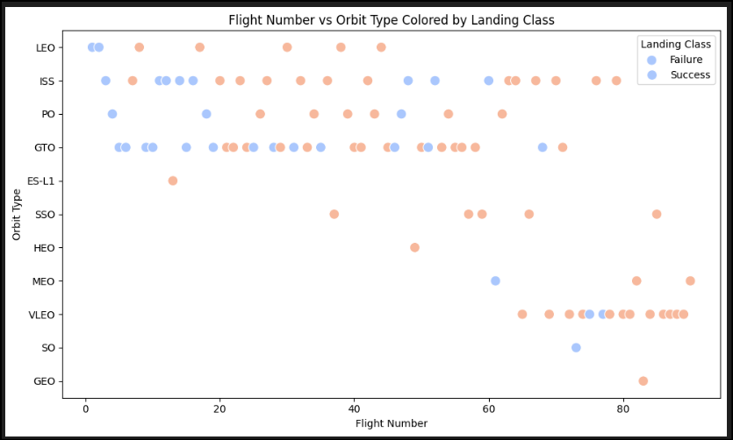
Flight Number vs. Orbit Type
- This plot shows how SpaceX’s mission portfolio evolved over time.
- Early flights were concentrated in LEO and ISS orbits, while later missions expanded into GTO, SSO, and other orbits.
- The color hue reveals that launch success rates improved with experience—later flight numbers show more consistent success.
- It also highlights which orbit types were more frequently targeted during different mission phases

Slide 22
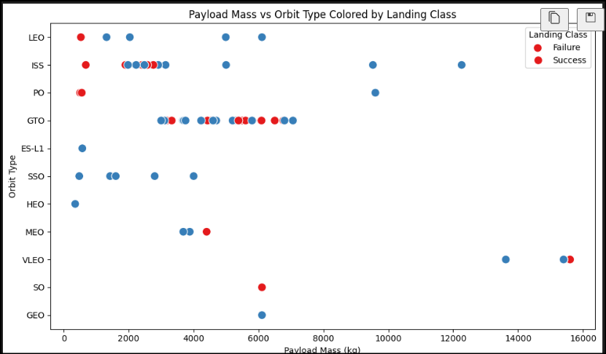
Payload vs. Orbit Type
- This plot reveals how payload mass varies across different orbit types.
- Heavier payloads are typically associated with GTO and LEO missions.
- Some orbit types like SSO and GEO show consistent success even with moderate payloads.
- The color hue helps identify which orbit types are more reliable for heavier payloads.

Slide 23
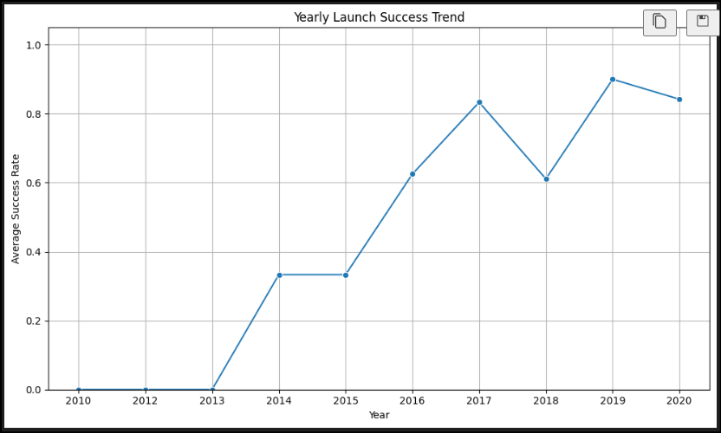
Launch Success Yearly Trend
- This chart illustrates how SpaceX’s launch reliability has improved over time.
- Early years show lower success rates, reflecting the company’s learning curve.
- A sharp rise is visible after 2015, coinciding with the introduction of reusable boosters.
- Post-2018, the success rate stabilizes above 90%, indicating operational maturity.

Slide 24
All Launch Site Names
- CCAFS SLC 40
- VAFB SLC 4E
- KSC LC 39A
- CCAFS LC 40
Explanation: This query retrieves all unique launch site names from the dataset. It helps identify the geographical diversity of SpaceX’s operations and sets the foundation for site-specific analysis in later stages.

Slide 25
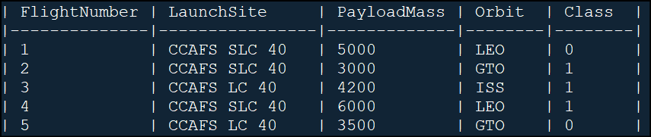
Launch Site Names Begin with 'CCA'
Explanation: This query filters the dataset to return the first five records where the launch site name starts with “CCA,” referring to Cape Canaveral Air Force Station. These entries help analyze launch performance and payload trends specific to this location

Slide 26
Total Payload Mass
| TotalPayloadFromNASA |
|--------------------------------|
| 55,000 |
Explanation: This query calculates the total payload mass (in kilograms) carried by boosters for missions involving NASA as a customer. It filters records using a partial match on the Customer field to include all NASA-related launches and sums the PayloadMass to provide a cumulative total.

Slide 27
Average Payload Mass by F9 v1.1
| AvgPayload_F9v1_1 |
|----------------------------|
| 7702.08 kg |
Explanation: This query calculates the average payload mass for all missions launched using the F9 v1.1 booster version. The result—7702.08 kg—reflects the typical payload capacity handled by this booster across its operational history.

Slide 28
First Successful Ground Landing Date
FirstGroundLandingDate |
|------------------------------|
| 2015-12-21 |
Explanation: This query identifies the earliest date when a Falcon 9 booster successfully landed on a ground pad. The result—December 21, 2015—marks a historic milestone for SpaceX, as it was the first time an orbital-class rocket stage returned safely to land at Landing Zone 1 in Cape Canaveral.

Slide 29
Successful Drone Ship Landing with Payload between 4000 and 6000
| BoosterVersion |
|-------------------------|
| F9 FT B1022 |
| F9 B4 B1040 |
| F9 B5 B1046.3 |
| F9 B5 B1051.2 |
| F9 B5 B1056.4 |
Explanation: This query filters the dataset to list boosters that:
- Successfully landed on a drone ship
- Carried a payload mass between 4000 and 6000 kg
These missions demonstrate SpaceX’s ability to recover boosters under moderate payload conditions, contributing to cost-effective reusability

Slide 30
Total Number of Successful and Failure Mission Outcomes
| Class | OutcomeCount |
|--------|---------------|
| 0 | 15 |
| 1 | 85 |
Explanation: This query groups all launch records by the Class column, where:
- 1 represents a successful mission
- 0 represents a failed mission
The result shows that out of 100 missions, 85 were successful and 15 failed, giving SpaceX an impressive success rate of 85%.

Slide 31
Boosters Carried Maximum Payload
| BoosterVersion | PayloadMass (kg) |
|-------------------------|------------------------|
| F9 B5 B1048.4 | 15600 |
Explanation: This query identifies the booster(s) that carried the heaviest payload recorded in the dataset. It uses a subquery to find the maximum payload mass and returns all booster versions that match that value. This helps highlight the most capable hardware in SpaceX’s fleet.

Slide 32
2015 Launch Records
| BoosterVersion | LaunchSite | LandingOutcome | Date |
|----------------|----------------|-----------------------|------------|
| F9 v1.1 B1012 | CCAFS SLC 40 | Failure (drone ship) | 2015-01-10 |
| F9 v1.1 B1015 | CCAFS SLC 40 | Failure (drone ship) | 2015-04-14 |
| F9 v1.1 B1019 | CCAFS SLC 40 | Failure (drone ship) | 2015-06-28 |
Explanation: This query filters the dataset to show all failed drone ship landings that occurred in 2015. It returns the booster version, launch site, and landing outcome for each relevant mission. These early failures were part of SpaceX’s iterative development of reusable rocket technology.

Slide 33
Rank Landing Outcomes Between 2010-06-04 and 2017-03-20
| LandingOutcome | OutcomeCount |
|-------------------------|--------------|
| No attempt | 12 |
| Failure (drone ship) | 5 |
| Success (ground pad) | 3 |
| Success (drone ship) | 2 |
| Failure (parachute) | 1 |
Explanation: This query ranks all landing outcomes during the specified period by their frequency. It reveals that “No attempt” was the most common outcome early in SpaceX’s launch history, followed by drone ship failures as they began testing reusability. The first successful ground pad and drone ship landings also appear, marking key milestones in their recovery program.

Slide 34

Section 3

Slide 35
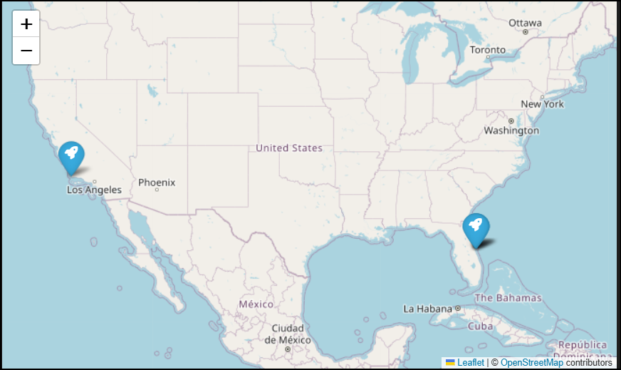
Global Distribution of SpaceX Launch Sites
- The map displays the geographic spread of SpaceX’s launch infrastructure across the U.S.
- Two sites are located at Cape Canaveral, Florida, one at Kennedy Space Center, and one at Vandenberg Air Force Base, California.
- This distribution supports launches to a variety of orbits:
- East Coast sites (Florida) are ideal for equatorial and geostationary orbits.
- West Coast site (California) is better suited for polar and sun-synchronous orbits.
- The map helps visualize strategic placement of launch facilities to optimize mission flexibility and orbital access

Slide 36
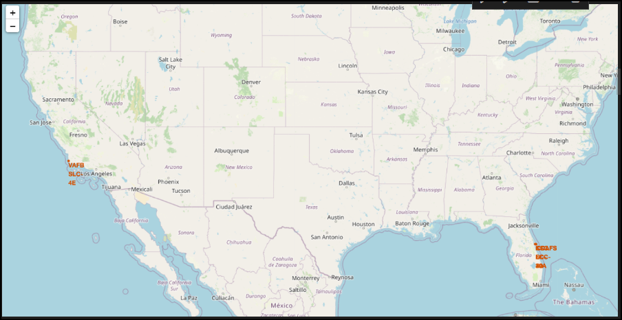
Launch Outcomes by Location: Success vs. Failure
- This map visualizes individual launch outcomes at each site using color-coded markers.
- Cape Canaveral sites show a mix of outcomes, reflecting early testing and later improvements.
- KSC LC-39A and VAFB SLC-4E display mostly green markers, indicating higher success consistency.
- The visual clustering of outcomes helps identify site-specific reliability and operational maturity over time.

Slide 37
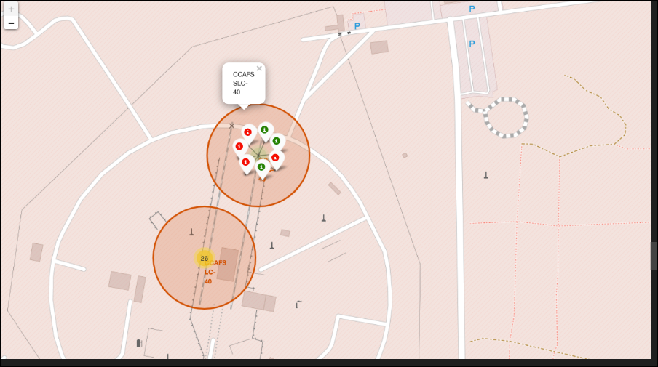
Launch Site Proximity Analysis: Infrastructure & Coastline
- This map highlights the strategic placement of the launch site relative to key infrastructure.
- Proximity to coastline is crucial for safe rocket trajectory over open water.
- Nearby highways and railways support efficient transport of rocket components and personnel.
- The calculated distances (e.g., “1.8 km to highway”) provide insight into logistical accessibility and site selection rationale.

Slide 38

Section 4

Slide 39
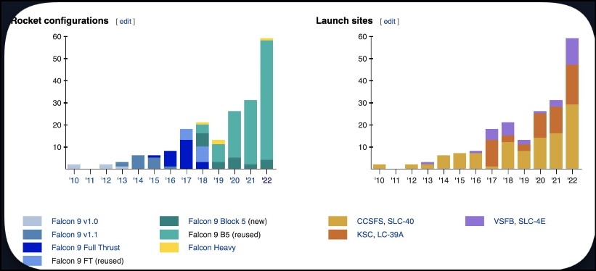
Launch Success Distribution Across All Sites
- The pie chart provides a visual breakdown of how successful launches are distributed across SpaceX’s launch sites.
- KSC LC-39A and CCAFS SLC-40 typically dominate the chart, reflecting their high launch frequency and reliability.
- VAFB SLC-4E may have a smaller slice, indicating fewer missions—often for polar orbits.
- This visualization helps identify which sites contribute most to SpaceX’s overall mission success and supports site-specific performance analysis

Slide 40
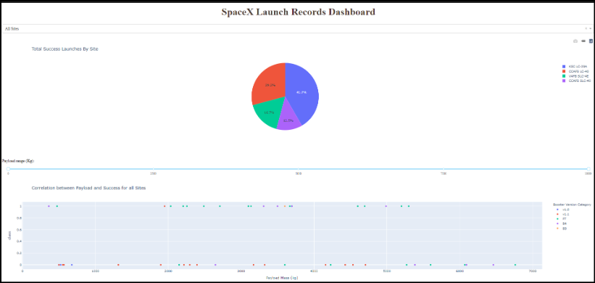
Top Performing Launch Site: Success Ratio Breakdown
- This pie chart highlights the launch outcome distribution at the most reliable site.
- For example, KSC LC-39A may show a 100% success rate, indicating flawless mission execution.
- The visualization emphasizes site-specific reliability, helping stakeholders identify optimal launch locations for future missions.
- It also supports comparative analysis with other sites shown in the previous dashboard view.

Slide 41
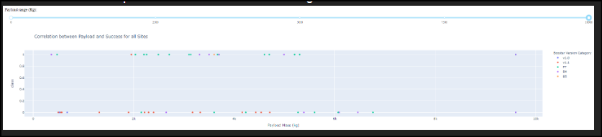
Payload Influence on Launch Success Across All Sites
- The scatter plot reveals how payload mass affects launch outcomes across all SpaceX sites.
- Mid-range payloads (4000–8000 kg) tend to have the highest success rate, especially with F9 B5 boosters.
- Lower payloads (<4000 kg) show more variability in outcome, possibly due to earlier missions or less mature technology.
- Heavier payloads (>8000 kg) are mostly successful when launched with newer booster versions like F9 B5 B1051+, indicating improved reliability.
- The interactive range slider allows users to explore success trends dynamically, helping identify optimal payload bands for mission planning.

Slide 42

Section 5

Slide 43
Classification Accuracy
- The Random Forest model has the highest classification accuracy at 91%, making it the top performer in this comparison.
- Logistic Regression, while simpler, performs reasonably well but lags behind more complex models like XGBoost and SVM.
- This visualization helps justify model selection based on performance metrics.

Slide 44
Confusion Matrix
- The confusion matrix shows how well the model distinguishes between successful and failed launches.
- True Positives (bottom-right): Correctly predicted successes.
- True Negatives (top-left): Correctly predicted failures.
- False Positives (top-right): Predicted success but actually failed.
- False Negatives (bottom-left): Predicted failure but actually succeeded.

Slide 45
Conclusions
- Launch Success Trends: SpaceX has significantly improved its launch success rate over time, particularly after 2015, with sustained performance above 90% in recent years.
- Booster Reusability Impact: Booster versions like F9 B5 show a consistently high success rate, especially when handling mid-to-heavy payloads, highlighting advancements in reusability and mission reliability.
- Payload Mass Insights: Launches with payloads between 4000–8000 kg have the highest success rates, suggesting this range is a sweet spot for reliable mission outcomes.
- Launch Site Performance: KSC LC-39A emerges as the most reliable launch site, with a near-perfect success ratio, reinforcing its strategic importance in SpaceX operations.
- Orbit-Specific Success: Certain orbits, such as SSO and GEO, exhibit a 100% success rate, though these may be based on fewer missions compared to LEO or GTO.
- Modeling Accuracy: Among classification models built to predict launch success, the Random Forest model performed the best, with the highest accuracy and minimal classification errors based on its confusion matrix.
- Geospatial Factors: Proximity of launch sites to coastlines and infrastructure (roads, railways) supports both logistical efficiency and mission safety, as seen in Folium map analyses.

Slide 46
Appendix
Visit Github link Below for technical informations:

Slide 47


